Slide 1
Does Working out Improve Mental Health?
A Research Study by Rahul Rajeev

Slide 2
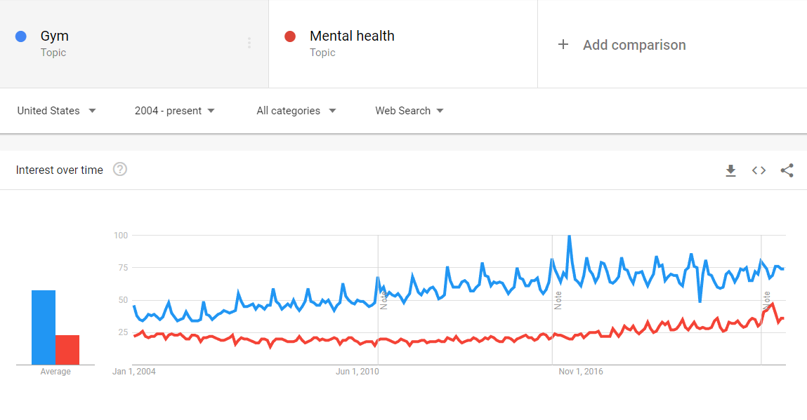
Introduction
Analyzing whether working out improves mental health through scientific research on the topic and perhaps formulating a plan to collect data and form.
Looking for correlation between mental health and gym factors such as motivation, set workout times, gym partners, and healthy diets.
Interest stems from Google Trends graphs demonstrating the relationship between the two in search engine data.
Figure 1 - Gym vs. Mental Health Searches (Google Trends, 2022)

Slide 3
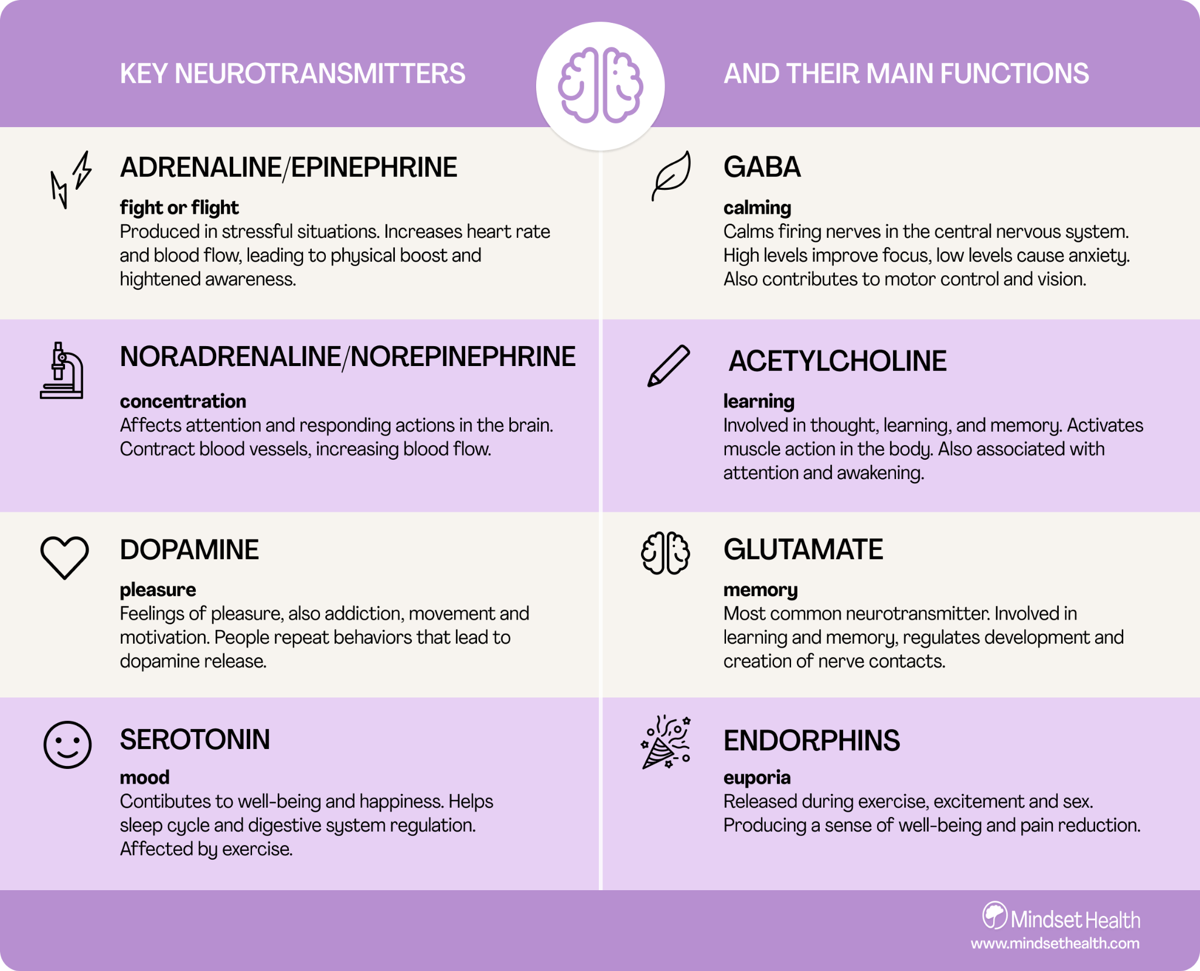
Research and Analysis
Working out is scientifically proven to improve mood through the release of certain neurotransmitters such as endorphin and endocannabinoids
For people battling mental health issues, working out could seem daunting at first. Here are some tips to start on your fitness journey:
Setting a workout schedule and finding preferences
Exercising with a buddy and taking breaks
Find the right amounts of exercise and levels of difficulty, don’t go overboard
Figure 2 - Key Neurotransmitters (Smith, 2021)

Slide 4
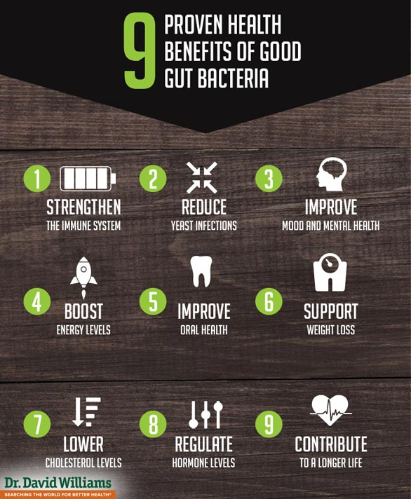
Research and Analysis (Cont.)
A healthy diet should also be followed as it does also have an effect on mood.
Sugar and processed foods lead to inflammation throughout the body and brain which may contribute to anxiety and depression (Sutter, n.d.)
Gut bacteria are beneficial to producing serotonin and mental health issues can affect the production.
Eating habits could be detrimental to a healthy diet
Individuals with severe eating disorders should seek help from professionals
Figure 3 - Benefits of Gut Bacteria (Williams, 2019)

Slide 5
Quality of Life Survey (Data Collection)
The primary data collection will be through a survey posted at gyms.
The quality of life survey will feature a questionnaire that will have personal questions that ask about workout type, exercise partners, and mental health history.
The aim will be to collect the data whether it be quantitative or qualitative and put them into a predictive model.
Neurotransmitter testing will also be administered to understand about neurotransmitter levels during each of the unique workouts
Testing will first be completed before and after workouts consistently, then on an interval basis.
The predictive model will take into account every factor that has been answered in the questionnaire and aim to prescribe those with mental health issues a workout that could possibly improve their mood and mental health state

Slide 6
Assumptions/Ethical Concerns/Challenges
Assumptions:
People’s interest in filling out a survey
Population of surveyees are of varying mental health states
Only receiving answers that pertain to people with great mental health
Gym’s interest in holding a study
Having space for people to take a survey that could take 15-20 minutes
Ethical Concerns:
Recording of medical information
Mental health history is very serious and any kind of breach could be horrible
Asking people to take the survey
Idealistic to expect everyone to take the survey
Could recommend as mandatory, but that could raise issues
Challenges:
Missing data due to ethical concerns
Creating a predictive model that successfully finds trends between all factors
Time to create the model

Slide 7
Conclusion
In conclusion, there appears to be a strong correlation between working out and improving mental health. With the help of the quality of life surveys and finding ways to solve the ethical concerns, we will be on the way to find new ways to combat mental health issues.
Later, additional opportunities that could arise with a successful case study and predictive model:
Utilizing data regarding diets as an extra factor for the predictive model. Healthy diets could be prescribed along workout routines for each individual
Researching whether specific gym clothes increase the effectiveness of a workout

Slide 8
Sources
trends.google.com (2012). Google Trends
Smith, J. (2021, January 27). Mindset minds: What is a neurotransmitter? Mindset Health.
Retrieved September 14, 2022, from
https://www.mindsethealth.com/matter/what-are-neurotransmitters
Williams, D. (2019, November 9). Good gut bacteria help prevent breast cancer. Protect Your Breasts.
Retrieved October 27, 2022, from https://protectyourbreasts.com/good-gut-bacteria-help-prevent-breast-cancer/

